Slide 1

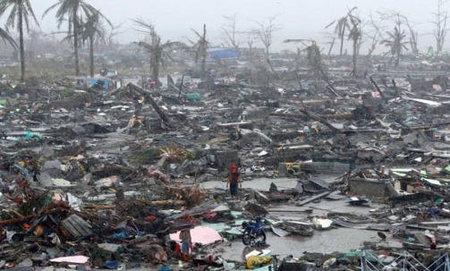
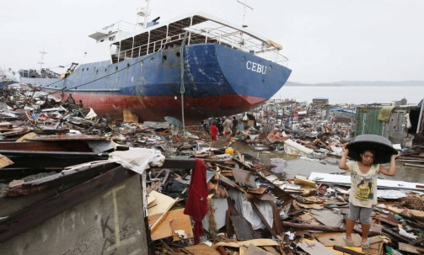
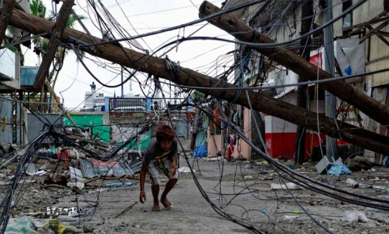
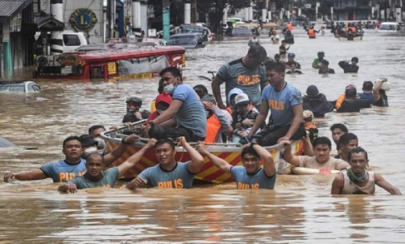
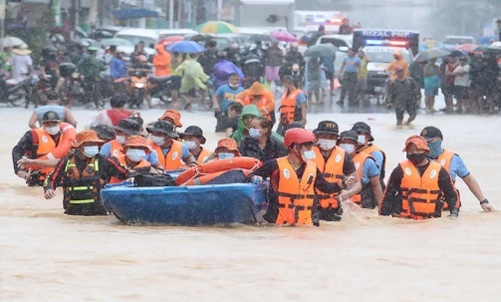
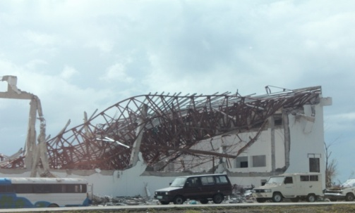


Impact-Based Forecasting (IBF) in the Philippines:
Department of Science and Technology (DOST)
Philippine Atmospheric, Geophysical and Astronomical Services Administration (PAGASA)
A Forecast Paradigm
ESCAP/WMO Typhoon Committee 16th Integrated Workshop, 02-03 December 2021
LORENZO A. MORON
Senior Weather Specialist
DOST-PAGASA
…. towards informed, risk-free and resilient community!

Slide 2

What’s inside?
Introduction
Highlights of IBF Development: The 6Ps
Pilot Testing
Benefits
Challenges
Way Forward

Slide 3
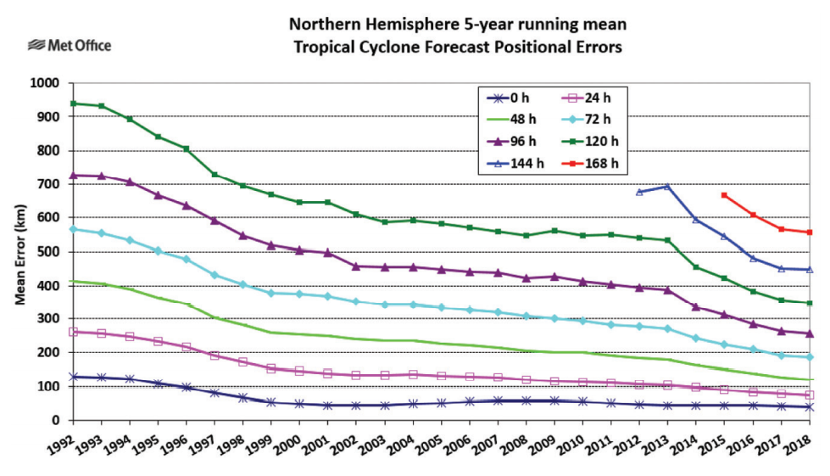
Question: Why do good forecast result in a poor response?
Although weather forecasting has significantly improved over time….

Slide 4
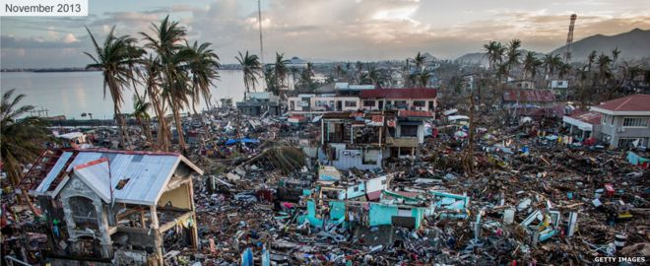
For example…
Typhoon Haiyan (Phillippines)
But WHAT HAPPENED???
6,201 dead, 28,626 injured and 1,785 missing.
More than sixteen million affected and more than US$827 million estimated for the damage of infrastructure and agriculture (NDRRMC 2014).
Were the WARNINGS enough???
Or the IMPACTS was not properly considered and/or was underestimated, and the response was inadequate…??
Although ACCURATE warnings were issued by PAGASA….
Although the potentials for heavy rainfall, severe wind and storm surges were explicitly stated and the regions to be most likely be affected….
Had there been better knowledge of the risks, particularly of the storm surge, it is likely that more extensive evacuations from exposed areas could have taken place sooner. (Not enough knowledge of storm surge impacts)

Slide 5


It is no longer enough to provide a good weather forecast or warning – people are now demanding information about what to do to ensure their safety and protect their property…
WMO(2015)
WMO Guidelines on Multi-hazard
Impact-based Forecast and Warning Services

Slide 6
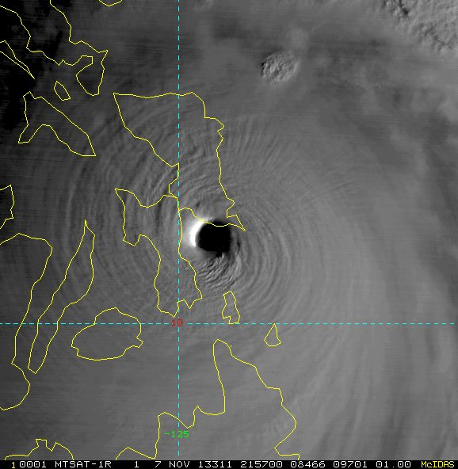
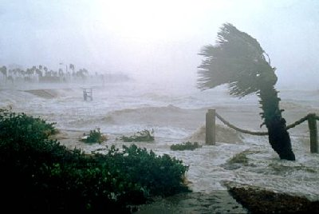
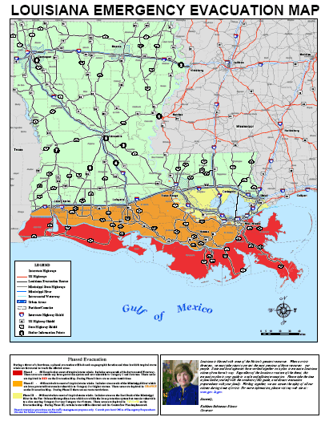
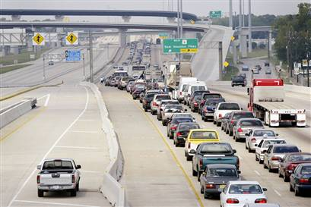
IMPACT-BASED FORECASTING AND EWS MODEL
Transforming from “What the Weather will Be” to “What the Weather Will Do”
Weather and
climate extremes
Weather
translation to
hazards
Impact
Estimation
Early actions
and early
response
Weather analyses
& forecast data
Extraction of relevant information
to predict hazards
Placing into situational context
Mitigation & Financing
Tropical cyclone track, size, & intensity
Storm surge, flooding, rain-induced landslide
Affected areas, population & infrastructure, disruption of services, damage due to wind & flood
Pre-emptive evacuation, early
harvesting, house strengthening,
release of emergency funds, cash transfer

Slide 7



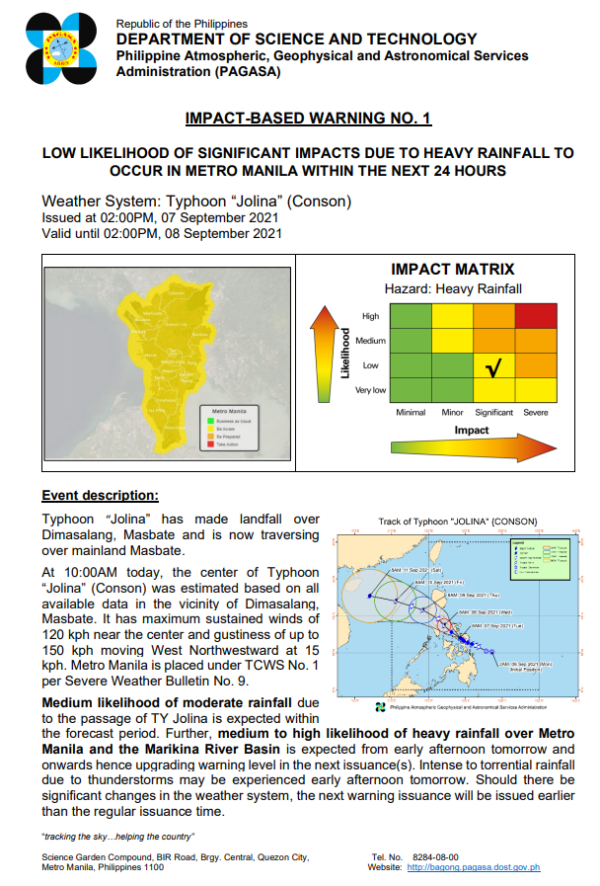

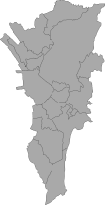

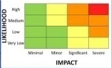
Highlights of IBF Development: The 6Ps
1
People
3
Probability of Loss
5
Phenomenon
Forecasters,
Researchers,
DRR Officers,
other stakeholders
Risk Assessment
Hazard
Exposure
Vulnerability
Weather Analysis
Map Discussion
Probabilistic Information
Predictability oh high-
impact weather
Decision for warning
IBF
Agreements/Collaborations
Data Gathering
Validations
NMHS-Stakeholders tie-up
Visualization
Risk Matrix
Decision Support
Generation of warning
Dissemination
Validations
2
Partnership
4
Platform
6
Publicize
Impact Tables, Response
Matrix, SOPs, Pilot Testing

Slide 8

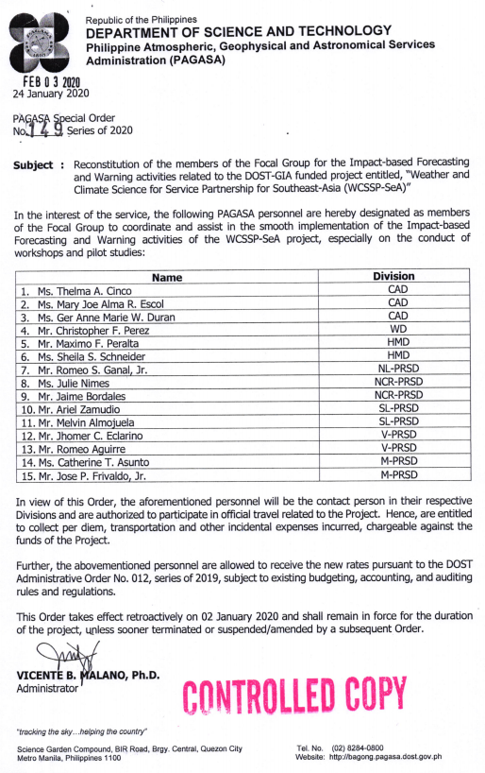
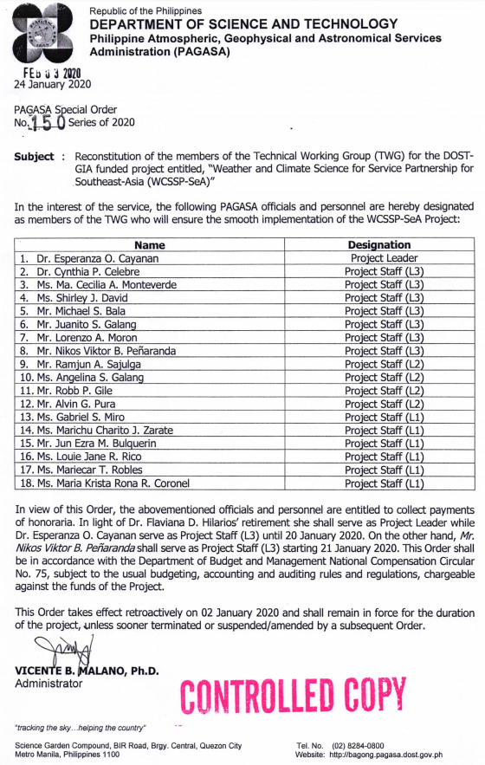
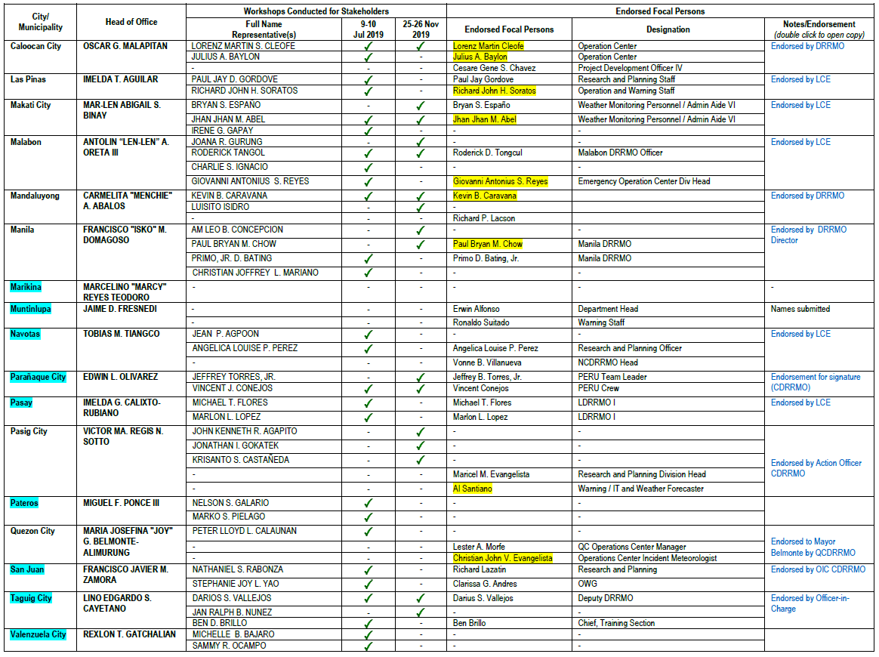
Developmental Activities – People
Forecasters and Researchers
Stakeholders

Slide 9
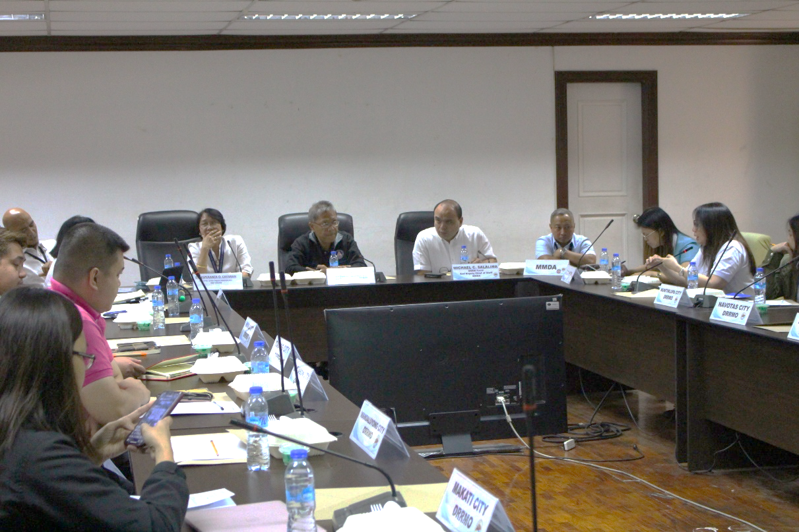
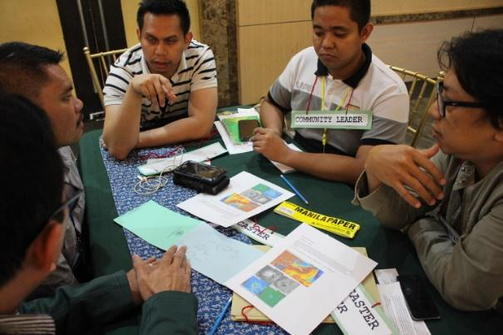
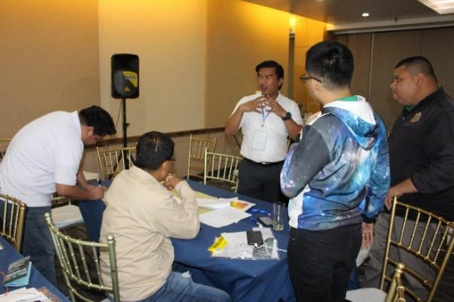
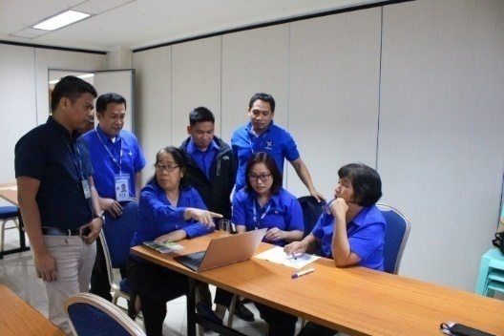
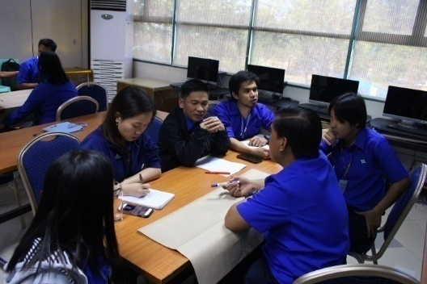
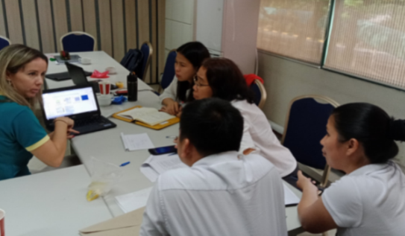
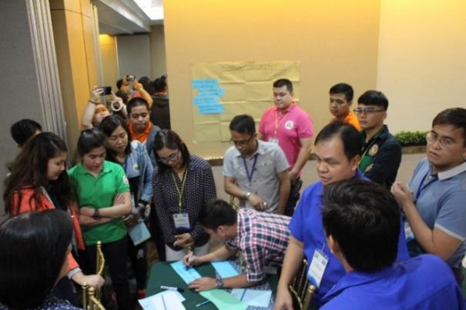
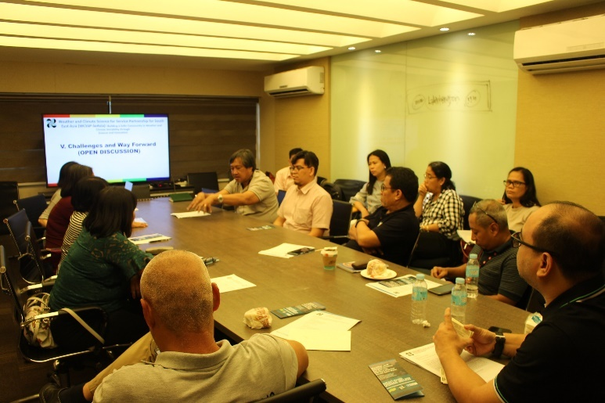
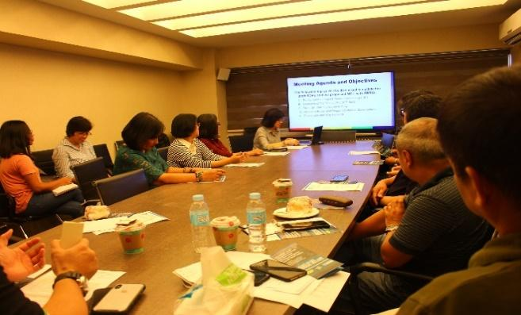
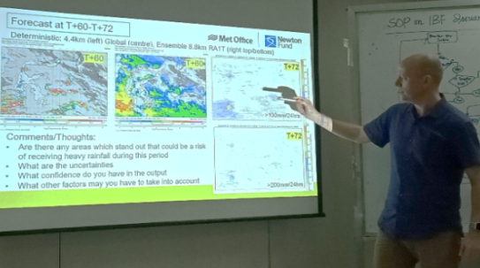
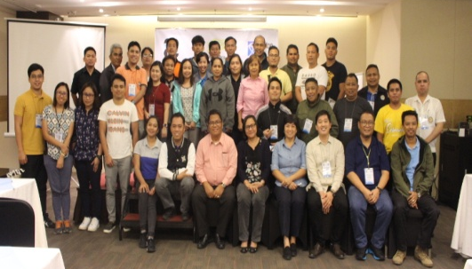
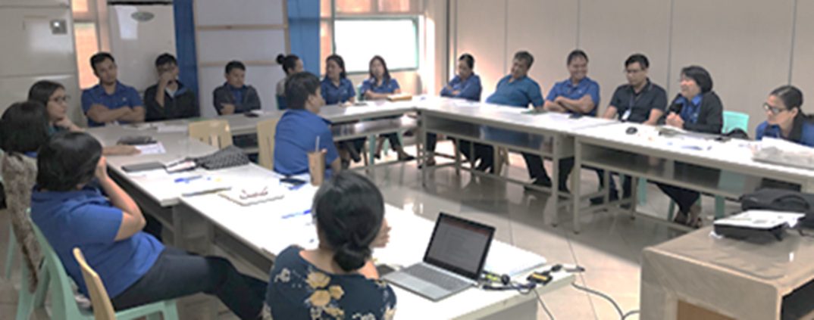
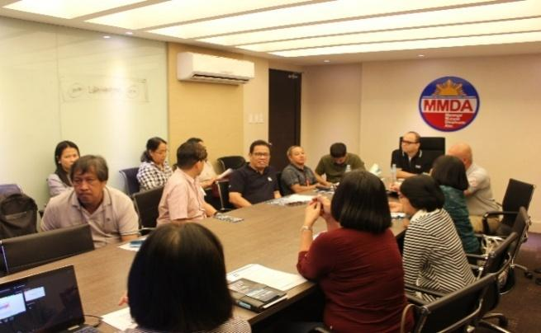
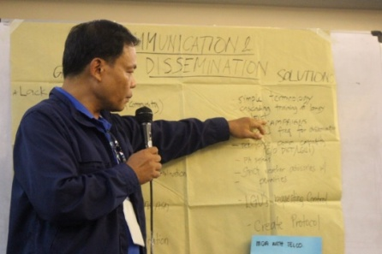
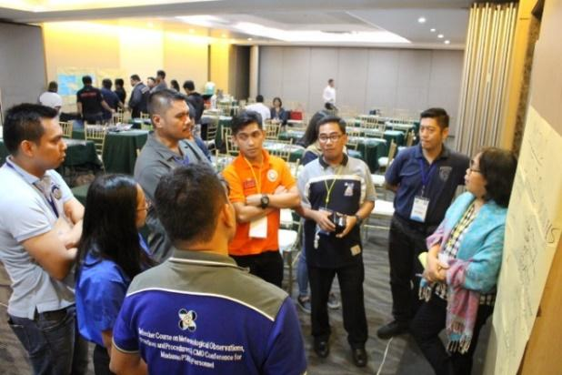
Developmental Activities - Partnership
Workshops and Consultative Meetings
Meeting with MMDRRMC
Meeting with MMDA
Meeting with PAGASA IBF TWG

Slide 10
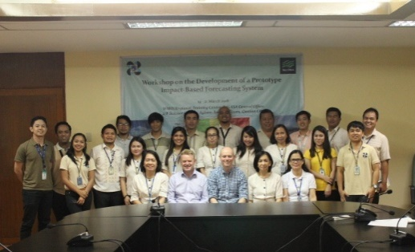
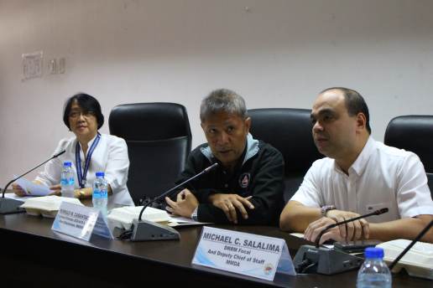
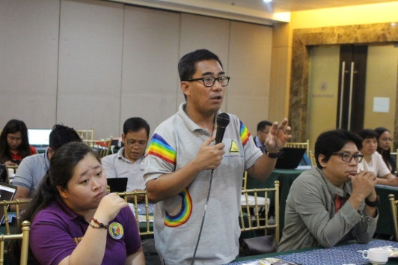
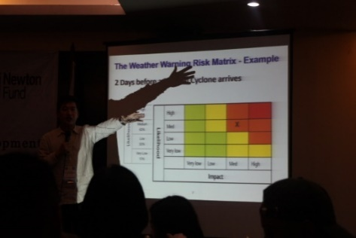
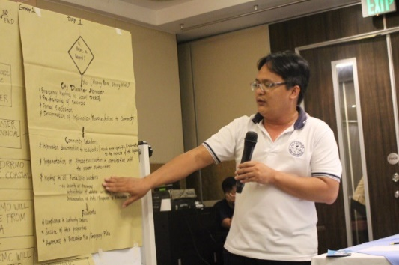
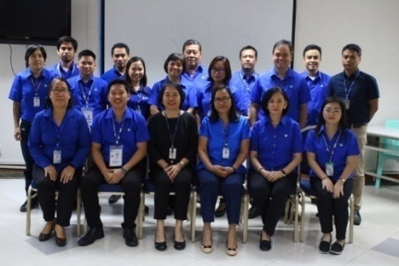
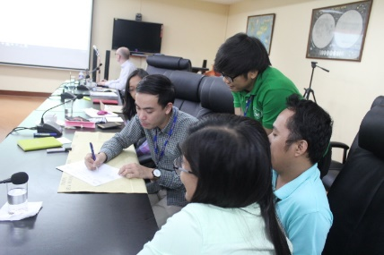
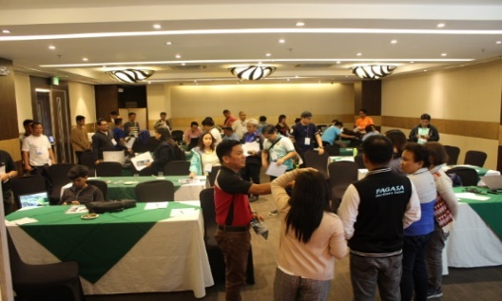
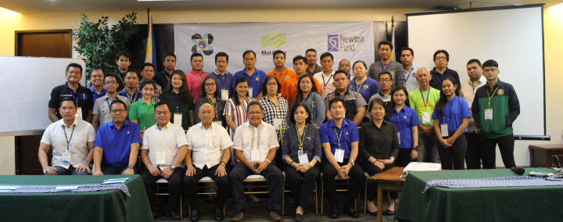
Developmental Activities - Partnership
Creation of PAGASA Focal Group
Development of a Prototype IBF System
(PAGASA, 19-21 March 2018)
Development of IBF System with the Focal Group
(PAGASA, 19-20 Feb. 2019)
Development of IBF System-Metro Manila
(Q.C., 09-10 Jul 2019)
Development of IBF System-Metro Manila
(Q.C., 09-10 Jul 2019)

Slide 11
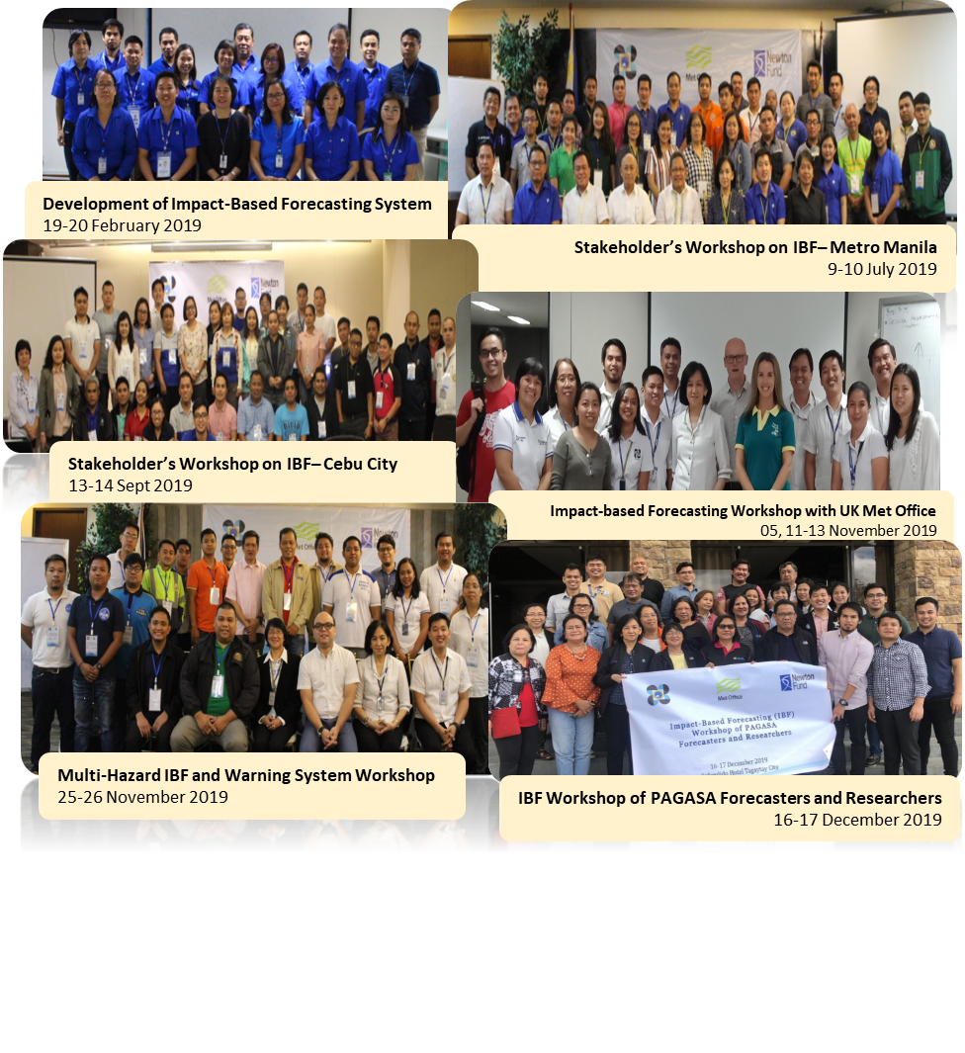
Developmental Activities - Partnership

Slide 12
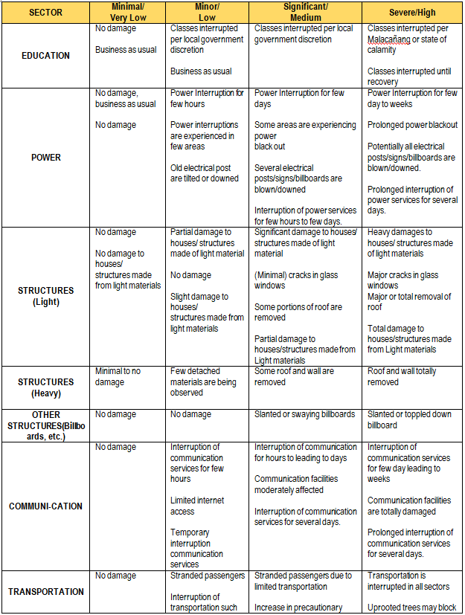
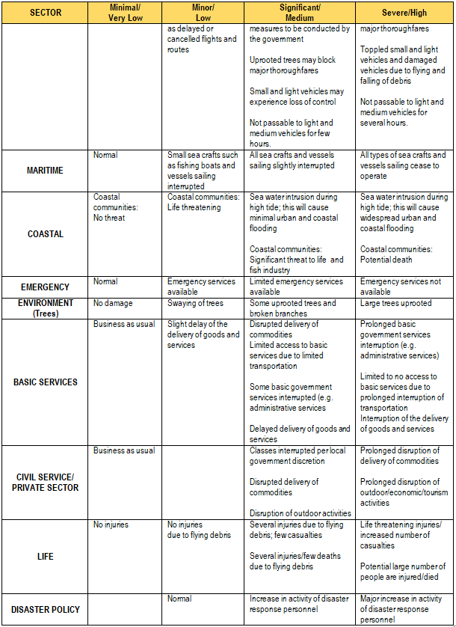
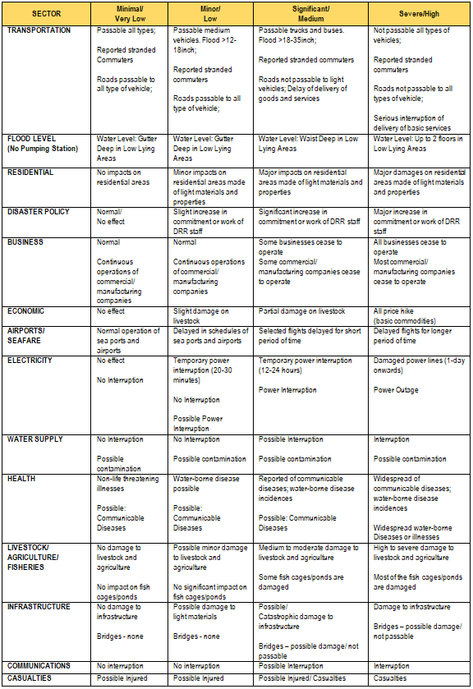
Developmental Activities - Partnership
Impact Table: Severe Wind
Impact Table: Heavy Rainfall

Slide 13
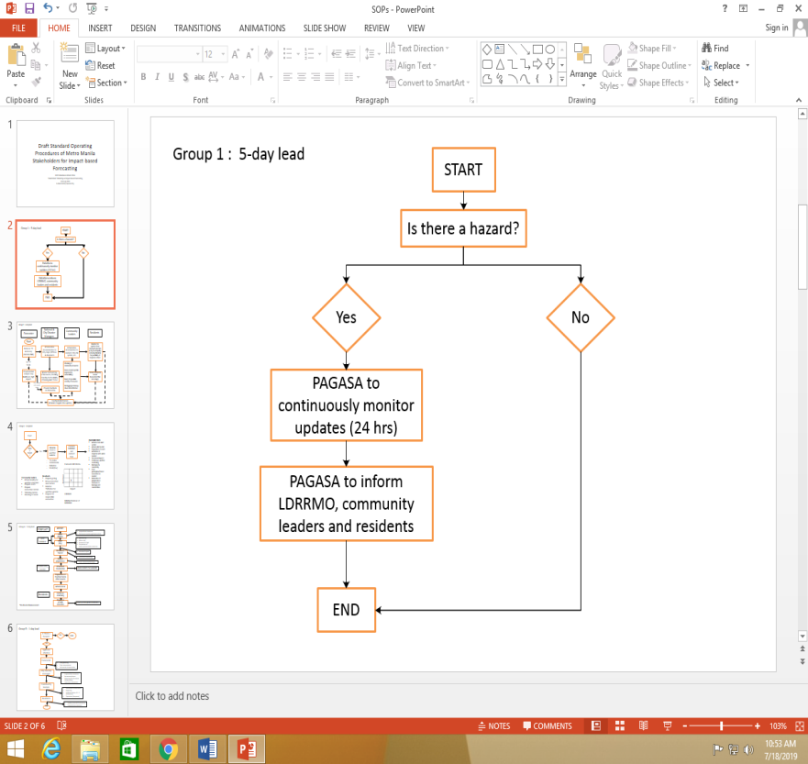
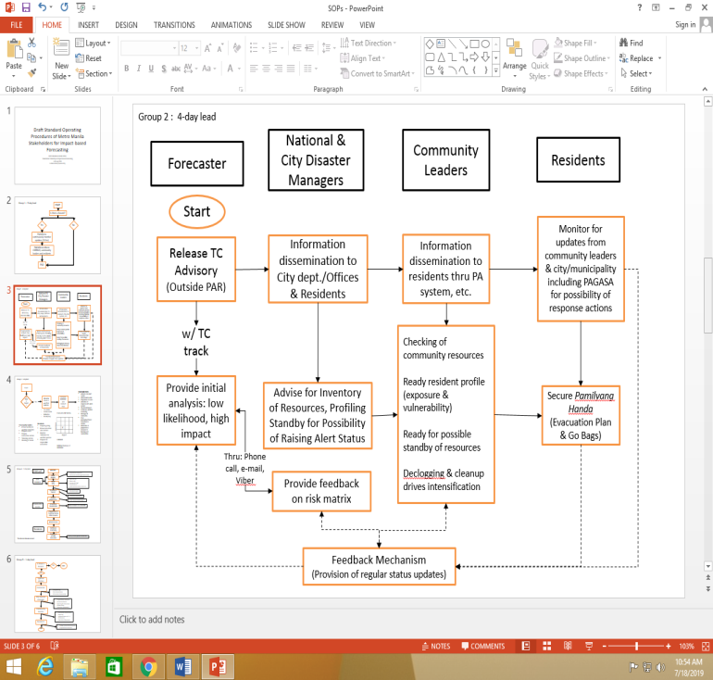
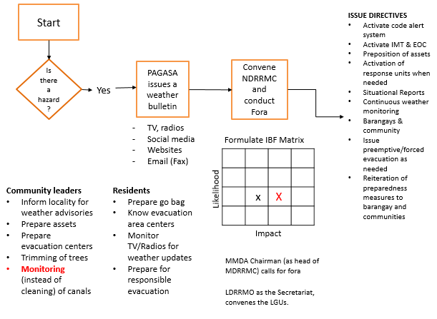
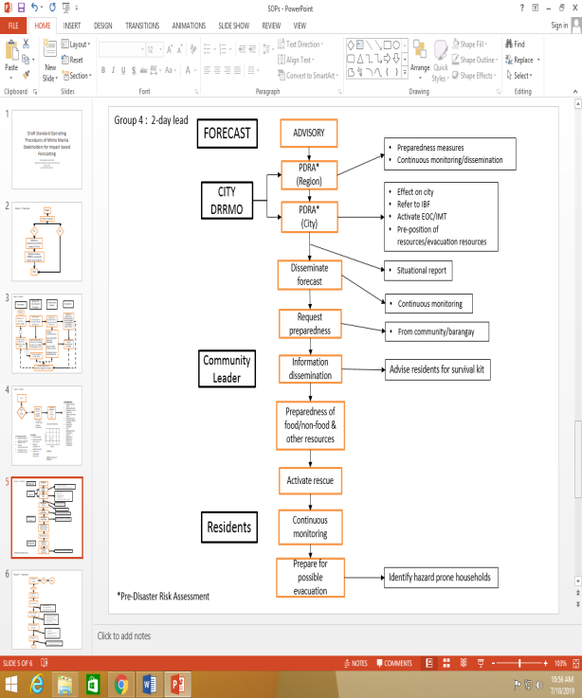

Developmental Activities - Partnership
5-day lead
4-day lead
3-day lead
Standard
Operating
Procedures
2-day lead
1-day lead

Slide 14













Developmental Activities - Partnership
Building Partnerships and Collaboration
Partners should work hand-in-hand towards effective, sustained and successful IBF operation: PAGASA needs to work in partnership with other government agencies and stakeholders (emergency response, mapping agencies, transport, public, etc..)
Data sharing among different agencies and departments vital (demographic, GIS and mapping, economic etc..)
The weather & climate
authority..
We need TEAMWORK in order to build and run the system!

Slide 15



Developmental Activities–Probability of Loss
RISK ASSESSMENT
Risk is the product of the likelihood of an event occurring, the impacts if the event occurs and the vulnerability of the area or populations.

Slide 16

Developmental Activities–Probability of Loss

Slide 17




Developmental Activities – Platform

Slide 18







Developmental Activities – Phenomenon
Weather Analysis and Map Discussions with PAGASA Forecasters,
NWP Specialists and Researchers

Slide 19






Developmental Activities – Phenomenon

Slide 20









Developmental Activities – Phenomenon
Monitor Weather
forecast and impacts
Forecast of Severe Weather
Consult with
Stakeholders
Finalize and issue /update warning
Step 1
C1 – Global: Predictability of High-Impact Weather Event through the analysis of large-scale drivers
Step 2
C2 – Regional: Predictability of High-Impact Weather Event in a local scale through probabilistic forecasting
√
Step 3
C3 – IBF Issuances and verification of model performances
Feedback/Evaluation Mechanism

Slide 21



Developmental Activities – Publicize

Slide 22
Developmental Activities – Publicize
RESPONSE MATRIX: RAINFALL (Suggested)
Very Low – No Action | Low – Be Aware | Medium – Be Prepared | High – Take Action
The NMHS will continue to monitor for any changing weather conditions | Be aware of flooding and stay out of flood waters. Evaluate inventory of emergency supplies (food, water, medical supplies); restock supplies as needed. Monitor roads and properties for localized flooding and possible traffic and public transportation disruptions. | Be aware of flooding and stay out of flood waters. Check emergency supplies , purchase additional supplies if needed, fill gas tanks, etc. Be prepared for localized flooding of roads and properties in low lying areas and land slippages that could block roads. Prepare possible delays or cancellation of public trans- portation services. | Stay out of flood waters and prepare to use emergency supplies. Avoid walking or driving through moving waters and seek safer/higher ground. Don’t drive and stay off roads in flood prone areas. Plan to shelter in place in non-flood areas.

Slide 23



PILOT TESTING: How we do it?
Stage 1
Stage 2
Stage 3
Establishing Linkages &
Team Organization
Risk Analysis &
IBF Forecast and Warning
Identifying Challenges, Benefits & Way Forward
Issues arising from the pilot testing
Communication with IBF Partners in
Cebu (PDRRMO, MDRRMOs, etc)
and other critical partners
Risk Map of Cebu
Probabilistic Forecasting
Benefits derived
Drafted Impact Tables
Feedback mechanisms
Communication with Regional
Forecasters
Preparation of Assessment Report
Analysis of Risk Matrix
IBF Visualization & Platform
Conduct more case studies/
Pilot Testing
Creation of Group Chat for easy
interaction
IBF Warning Flow
Continuous refinement of impact
tables, SOPs, etc.
Roles and Responsibilities of
Focal Persons
Warning Dissemination Protocol

Slide 24









PILOT TESTING: How do we evaluate?
Severe Wind
Malabon City
Makati City
Quezon City
Heavy Rainfall
Malabon City
Makati City
Quezon City

Slide 25




PILOT TESTING: How do we evaluate?
Flooding in Makati City

Slide 26





PILOT TESTING: How do we evaluate?
Flooding in Marikina City
Source : CNN (FB)
Dama de Noche Street, Twinville Subdivision, Concepcion Uno, Marikina City
Situation in Tumana Marikina City
Source: Mark Demayo, ABS-CBN News
Source: JD Ordonez
Source: Presh Ponce

Slide 27


BENEFITS OF IBF

Slide 28

BENEFITS OF IBF

Slide 29

BENEFITS OF IBF

Slide 30
WAY FORWARD
Refinement of Impact Tables, SOPs, etc.
Conduct more case studies
Establishment of legal agreements between PAGASA and Stakeholders
Improvement of IBF Visualization Platform
More capacity buildings on IBF
Establishment of Impact Data Library
Development of IBF Guidebook

Slide 31

IBF Roadmap
2019
2020 - 2021

Slide 32
Thank You!

